Slide 1
Instaplow
Alexander Aroesty – Electrical Systems Specialist
Andre Brueckner- Project Manager
Clinton Coleman – Manufacturing Specialist
Ryan Tita – Fabrication Specialist
Chris Wargo - SolidWorks Specialist
Rick Davids (Client)
Dr. Riley (Mentor)

Slide 2
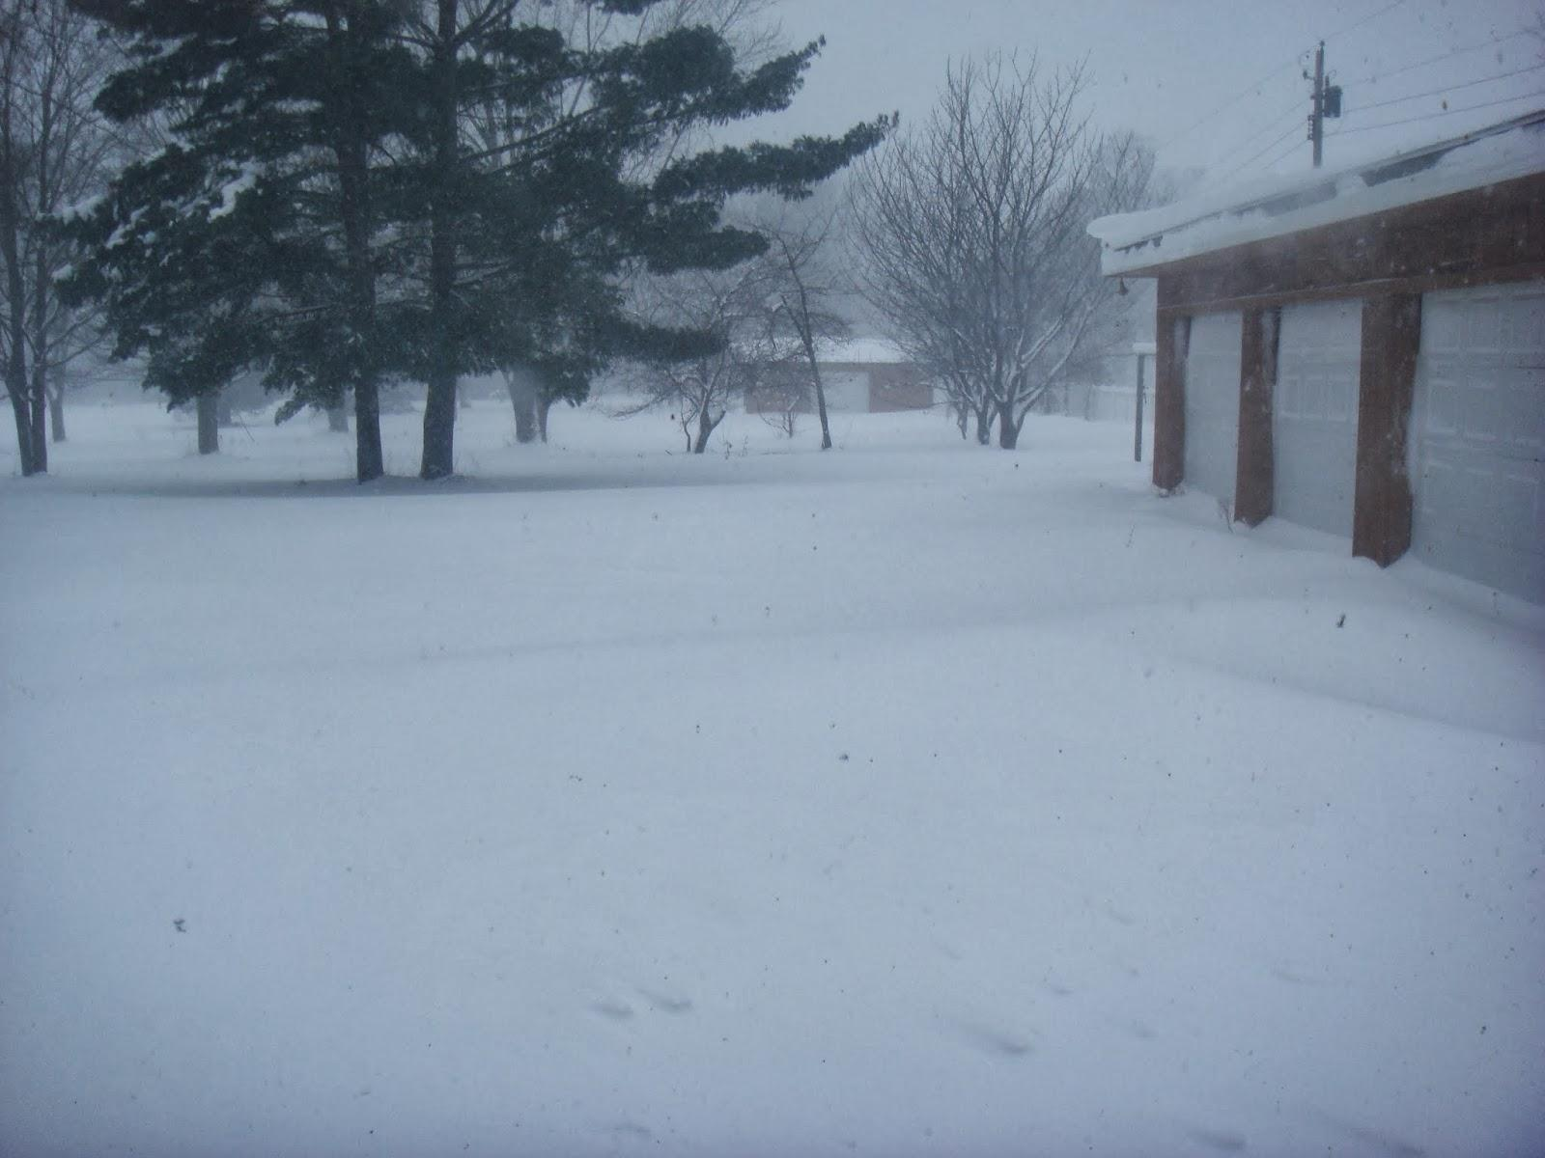
The Project
Easy to use lightweight snowplow
Inflatable
Attaches to front
Cost less than $200
Full scale prototype

Slide 3
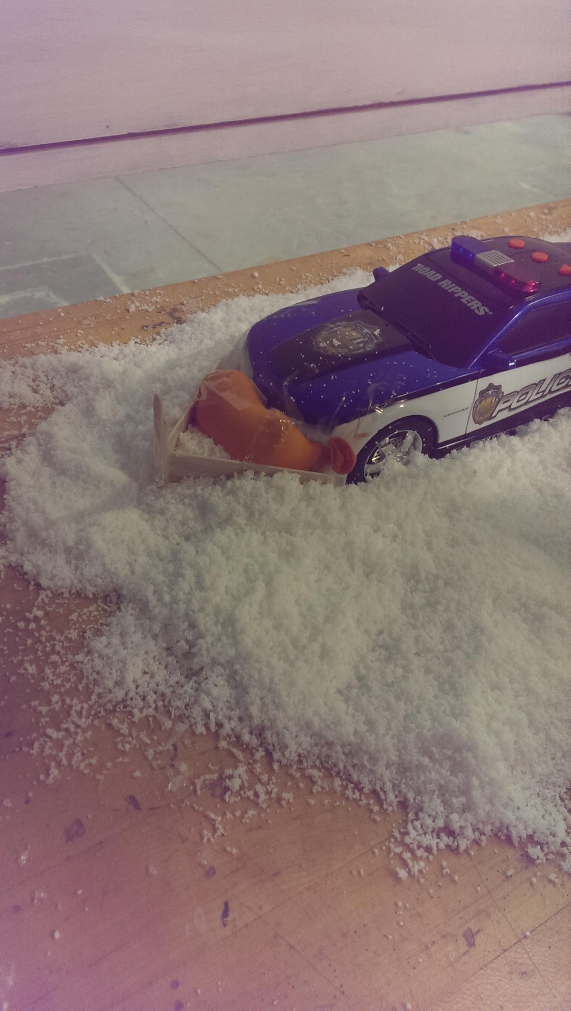
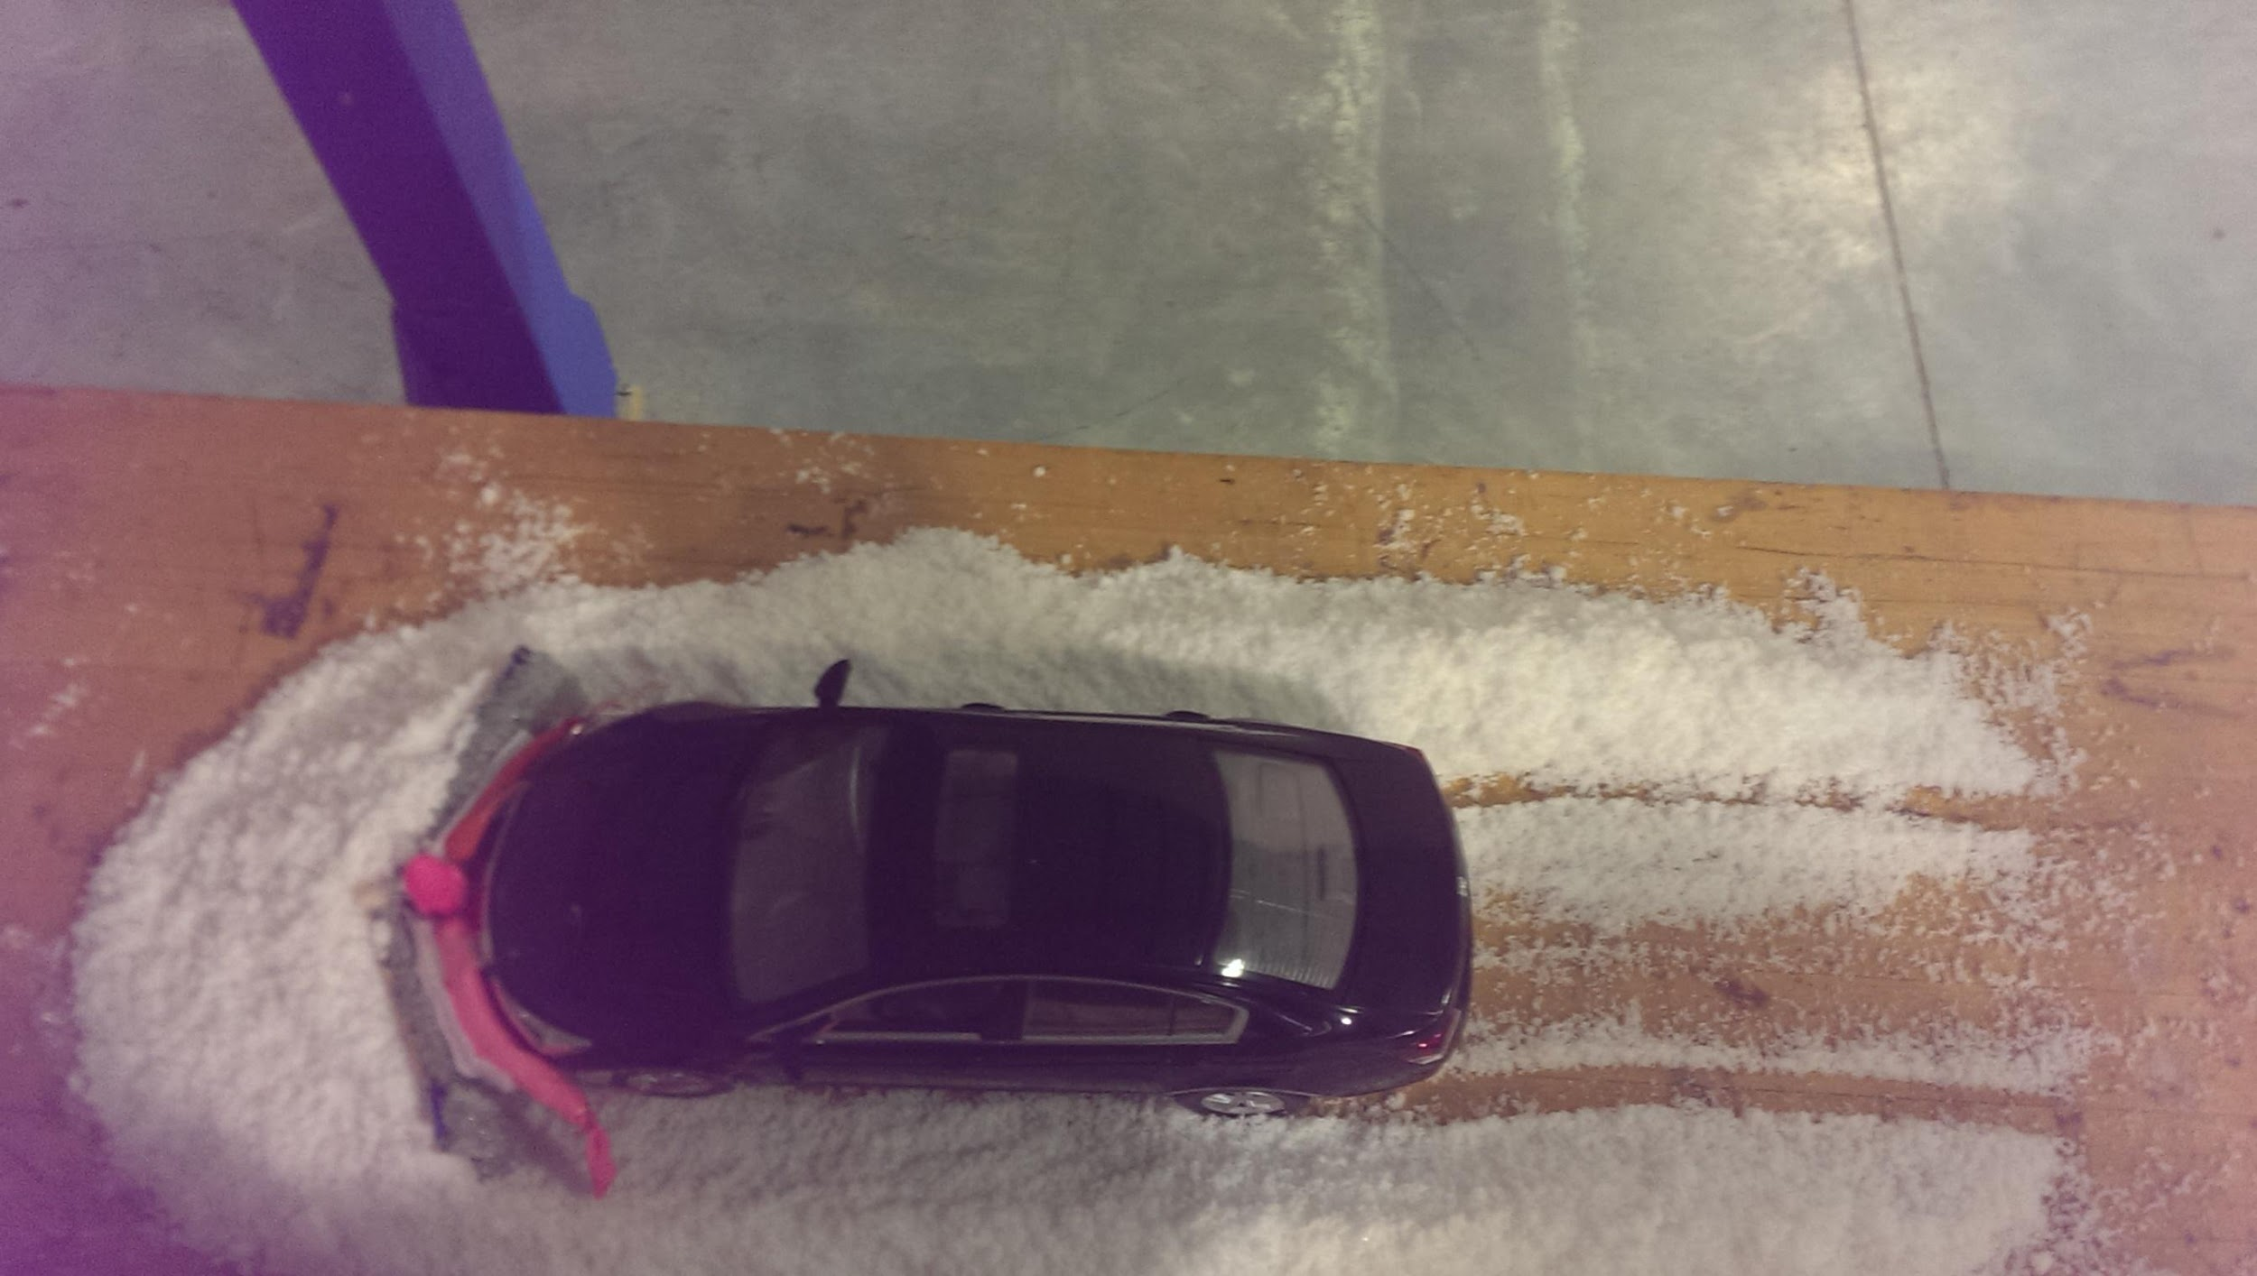
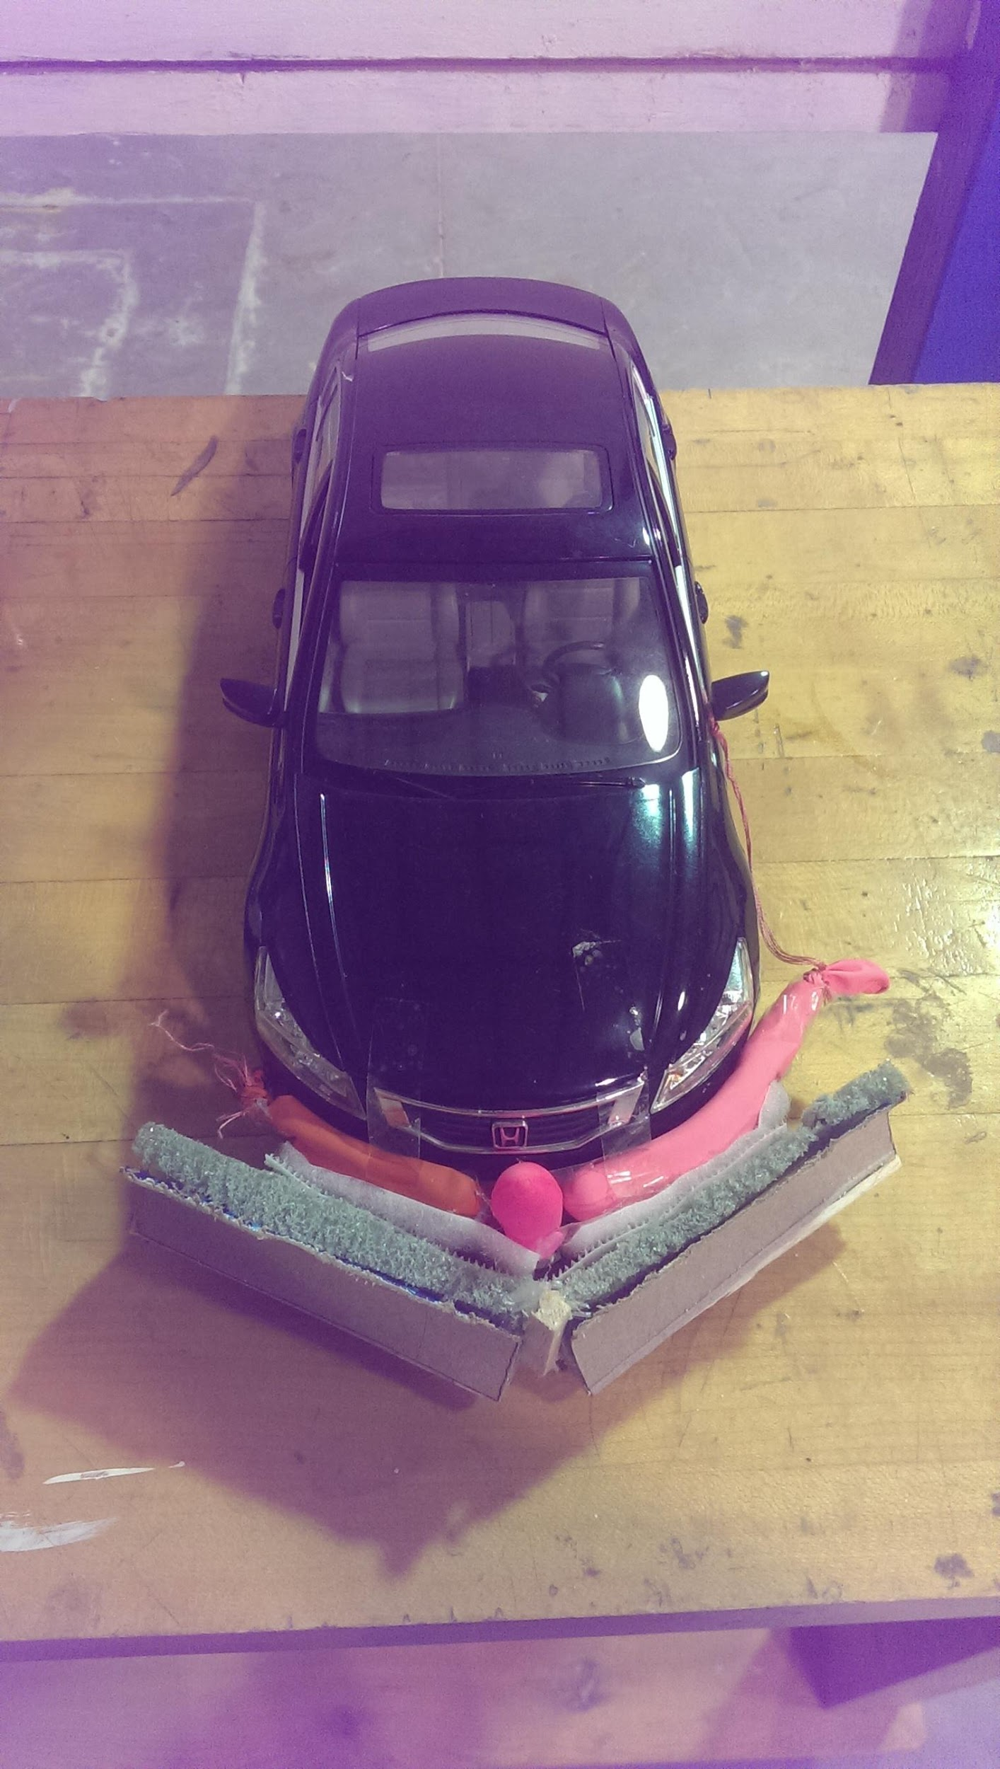
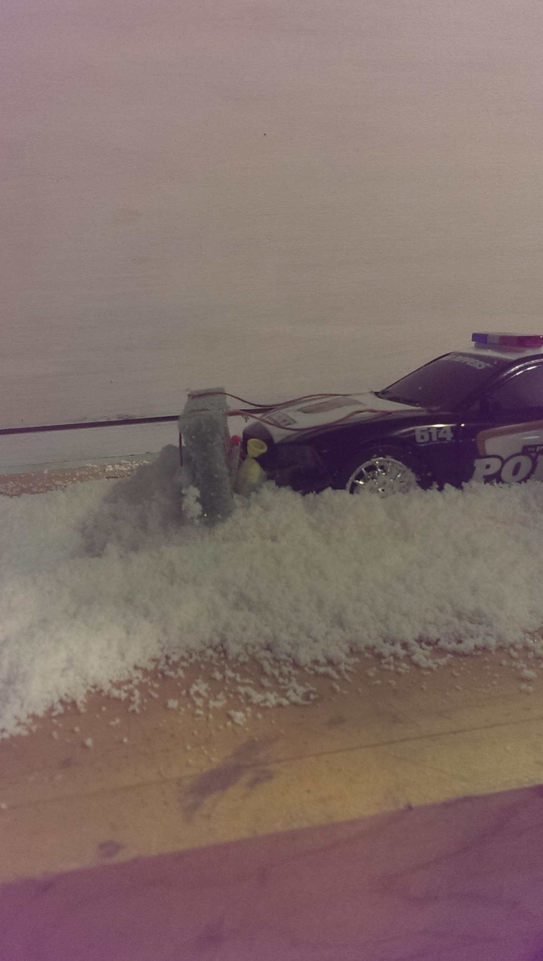
Table Top Modeling

Slide 4
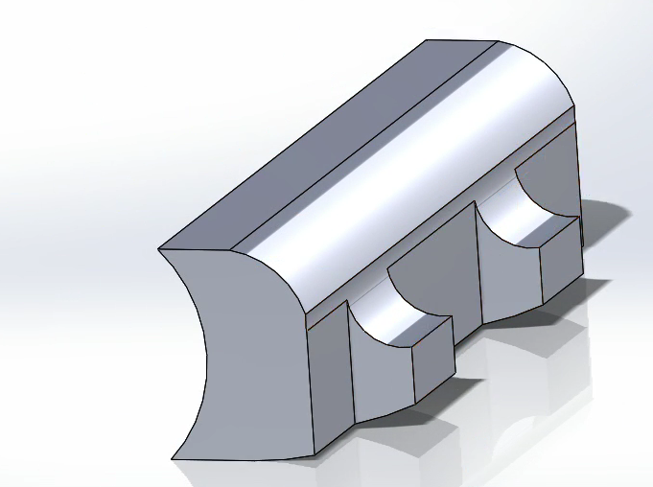
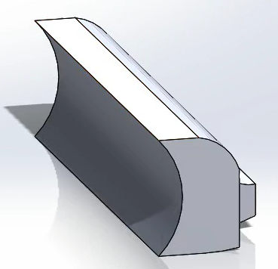
Straight plow

Slide 5
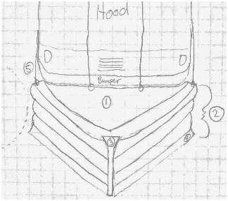
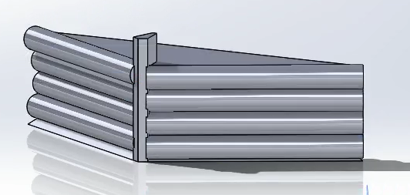
Fully inflatable V-Plow
Design Features
Triangular inflatable interface
4 inflatable compartments
Rigid plow tip

Slide 6
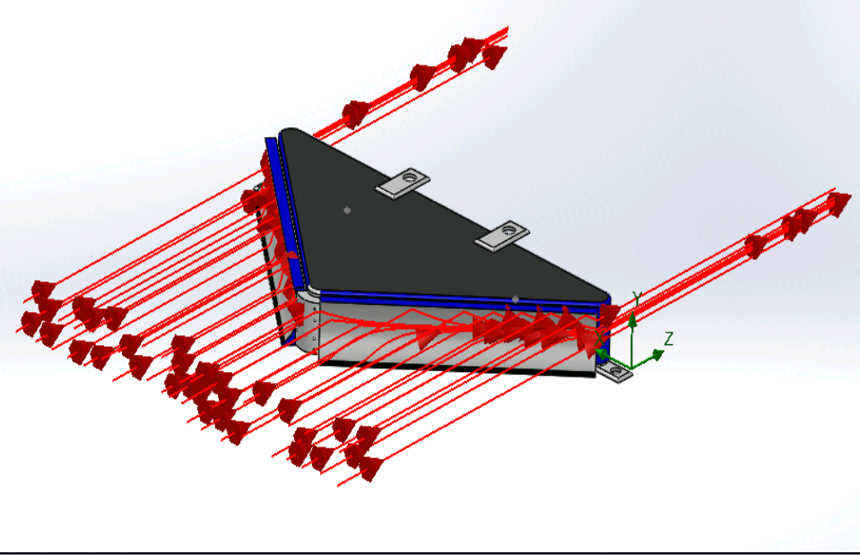
Hybrid 2 Compartment Design

Slide 7
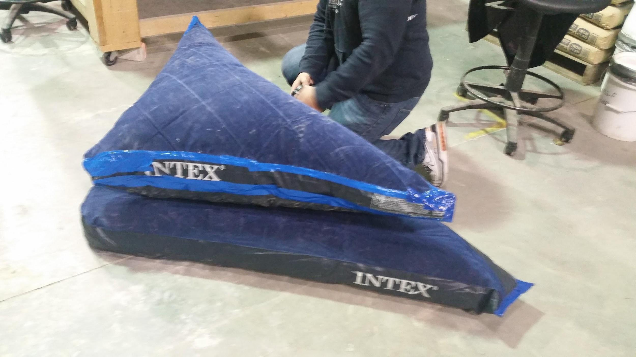
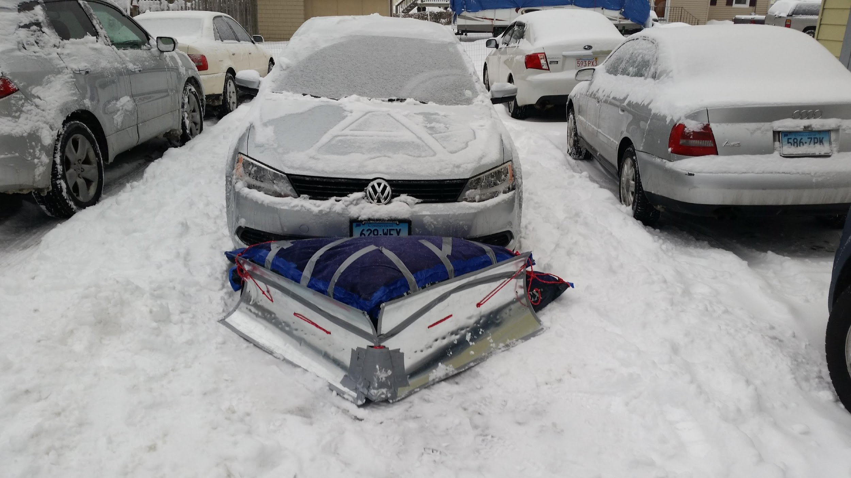
Prototype:1-A

Slide 8
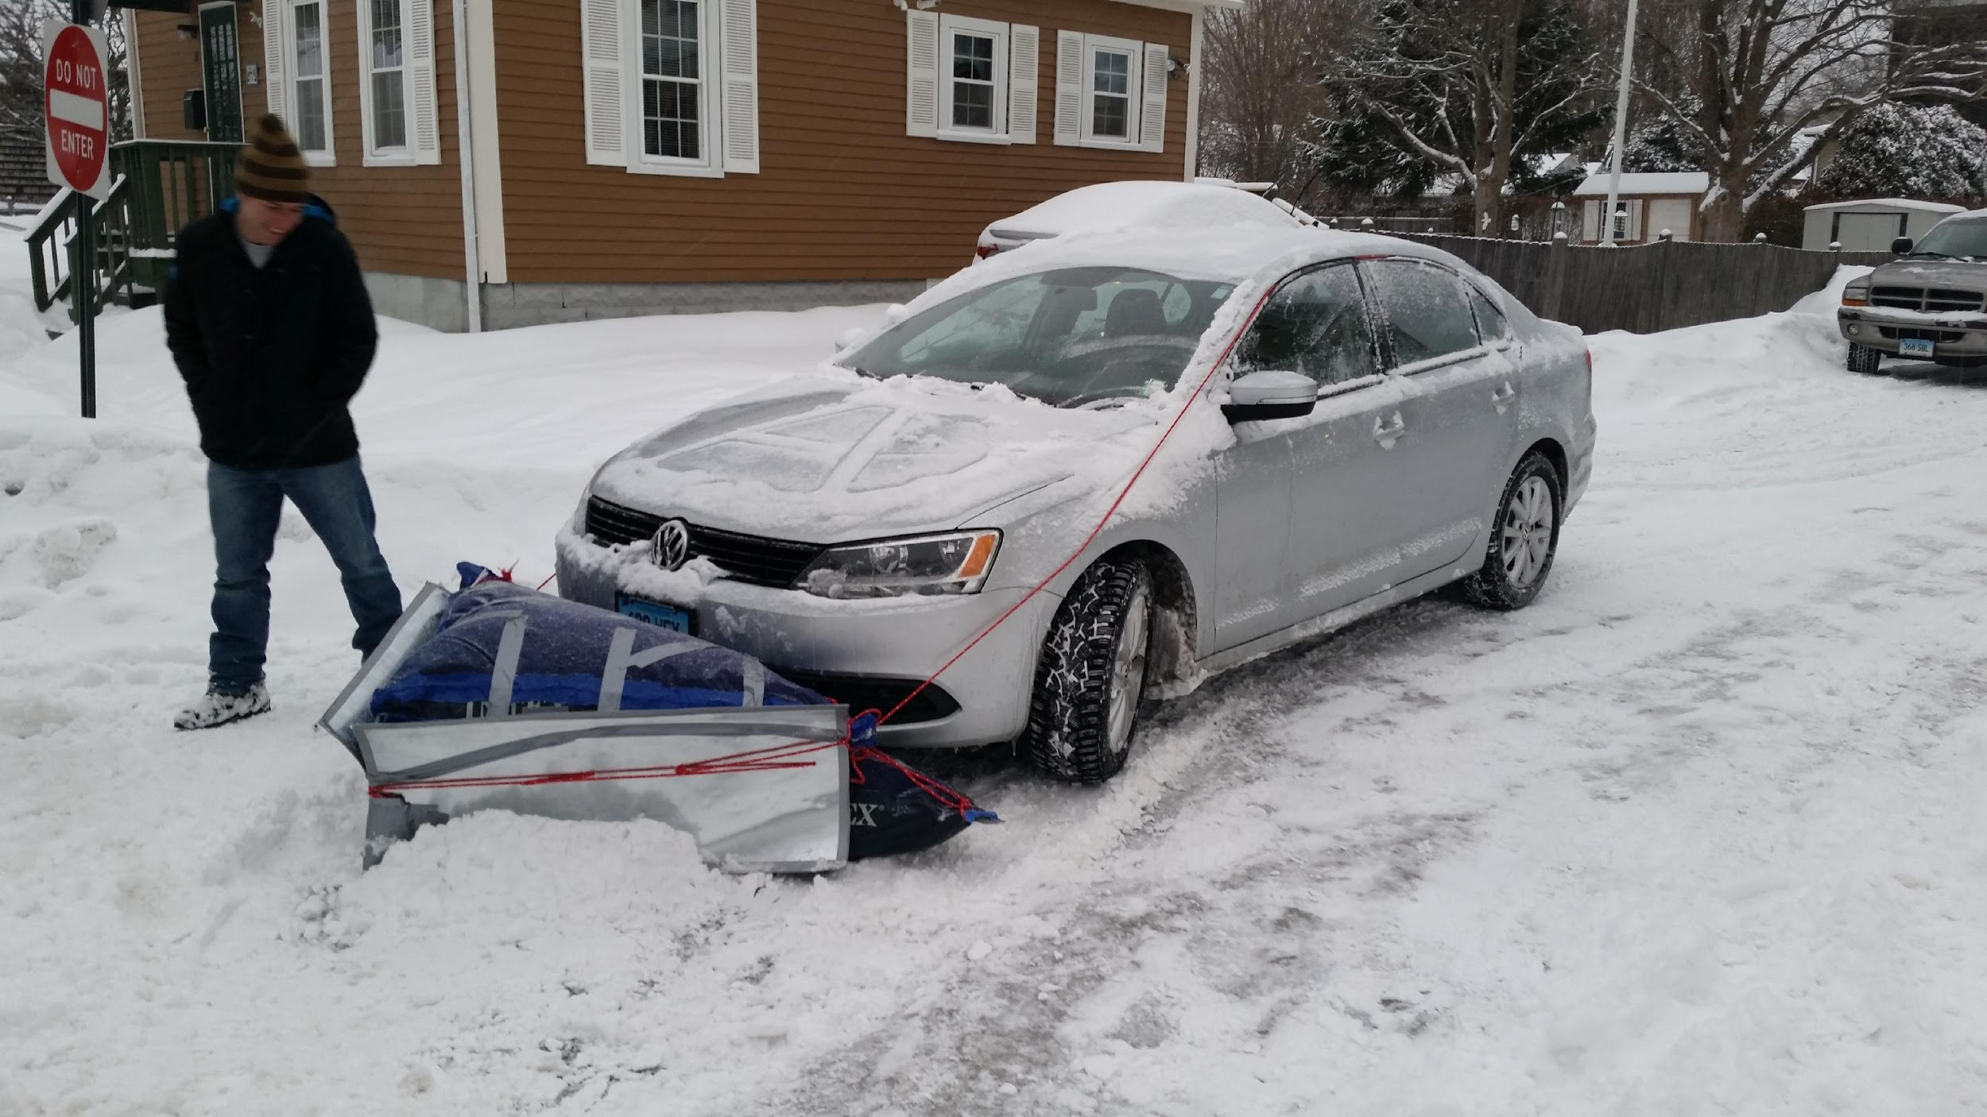
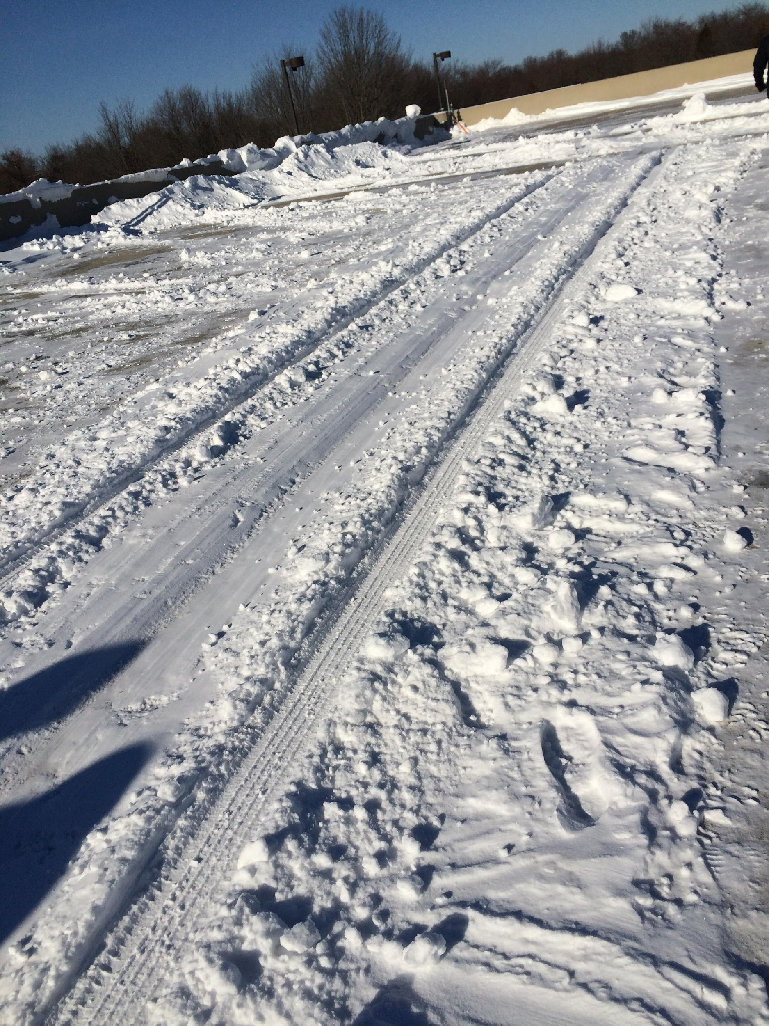
Prototype:1-A Testing

Slide 9
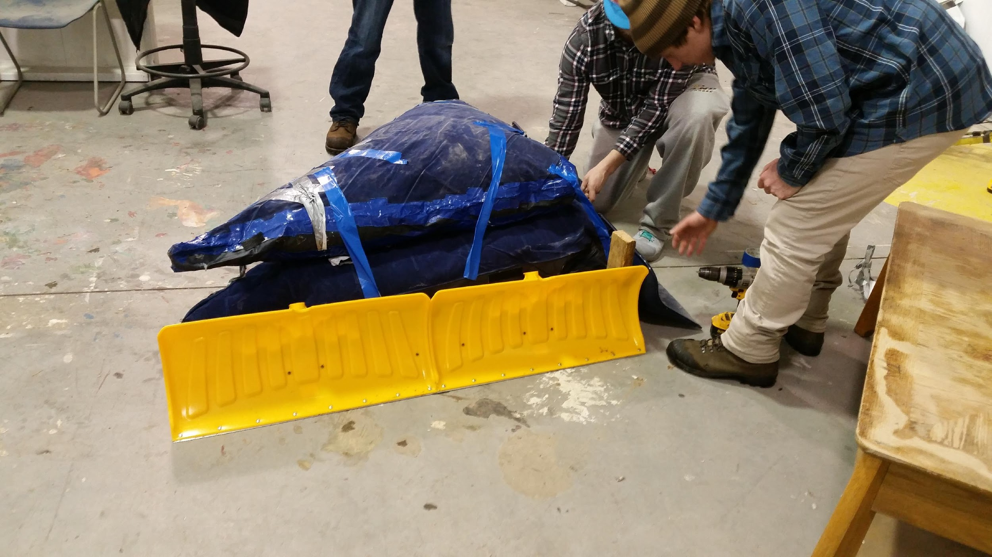
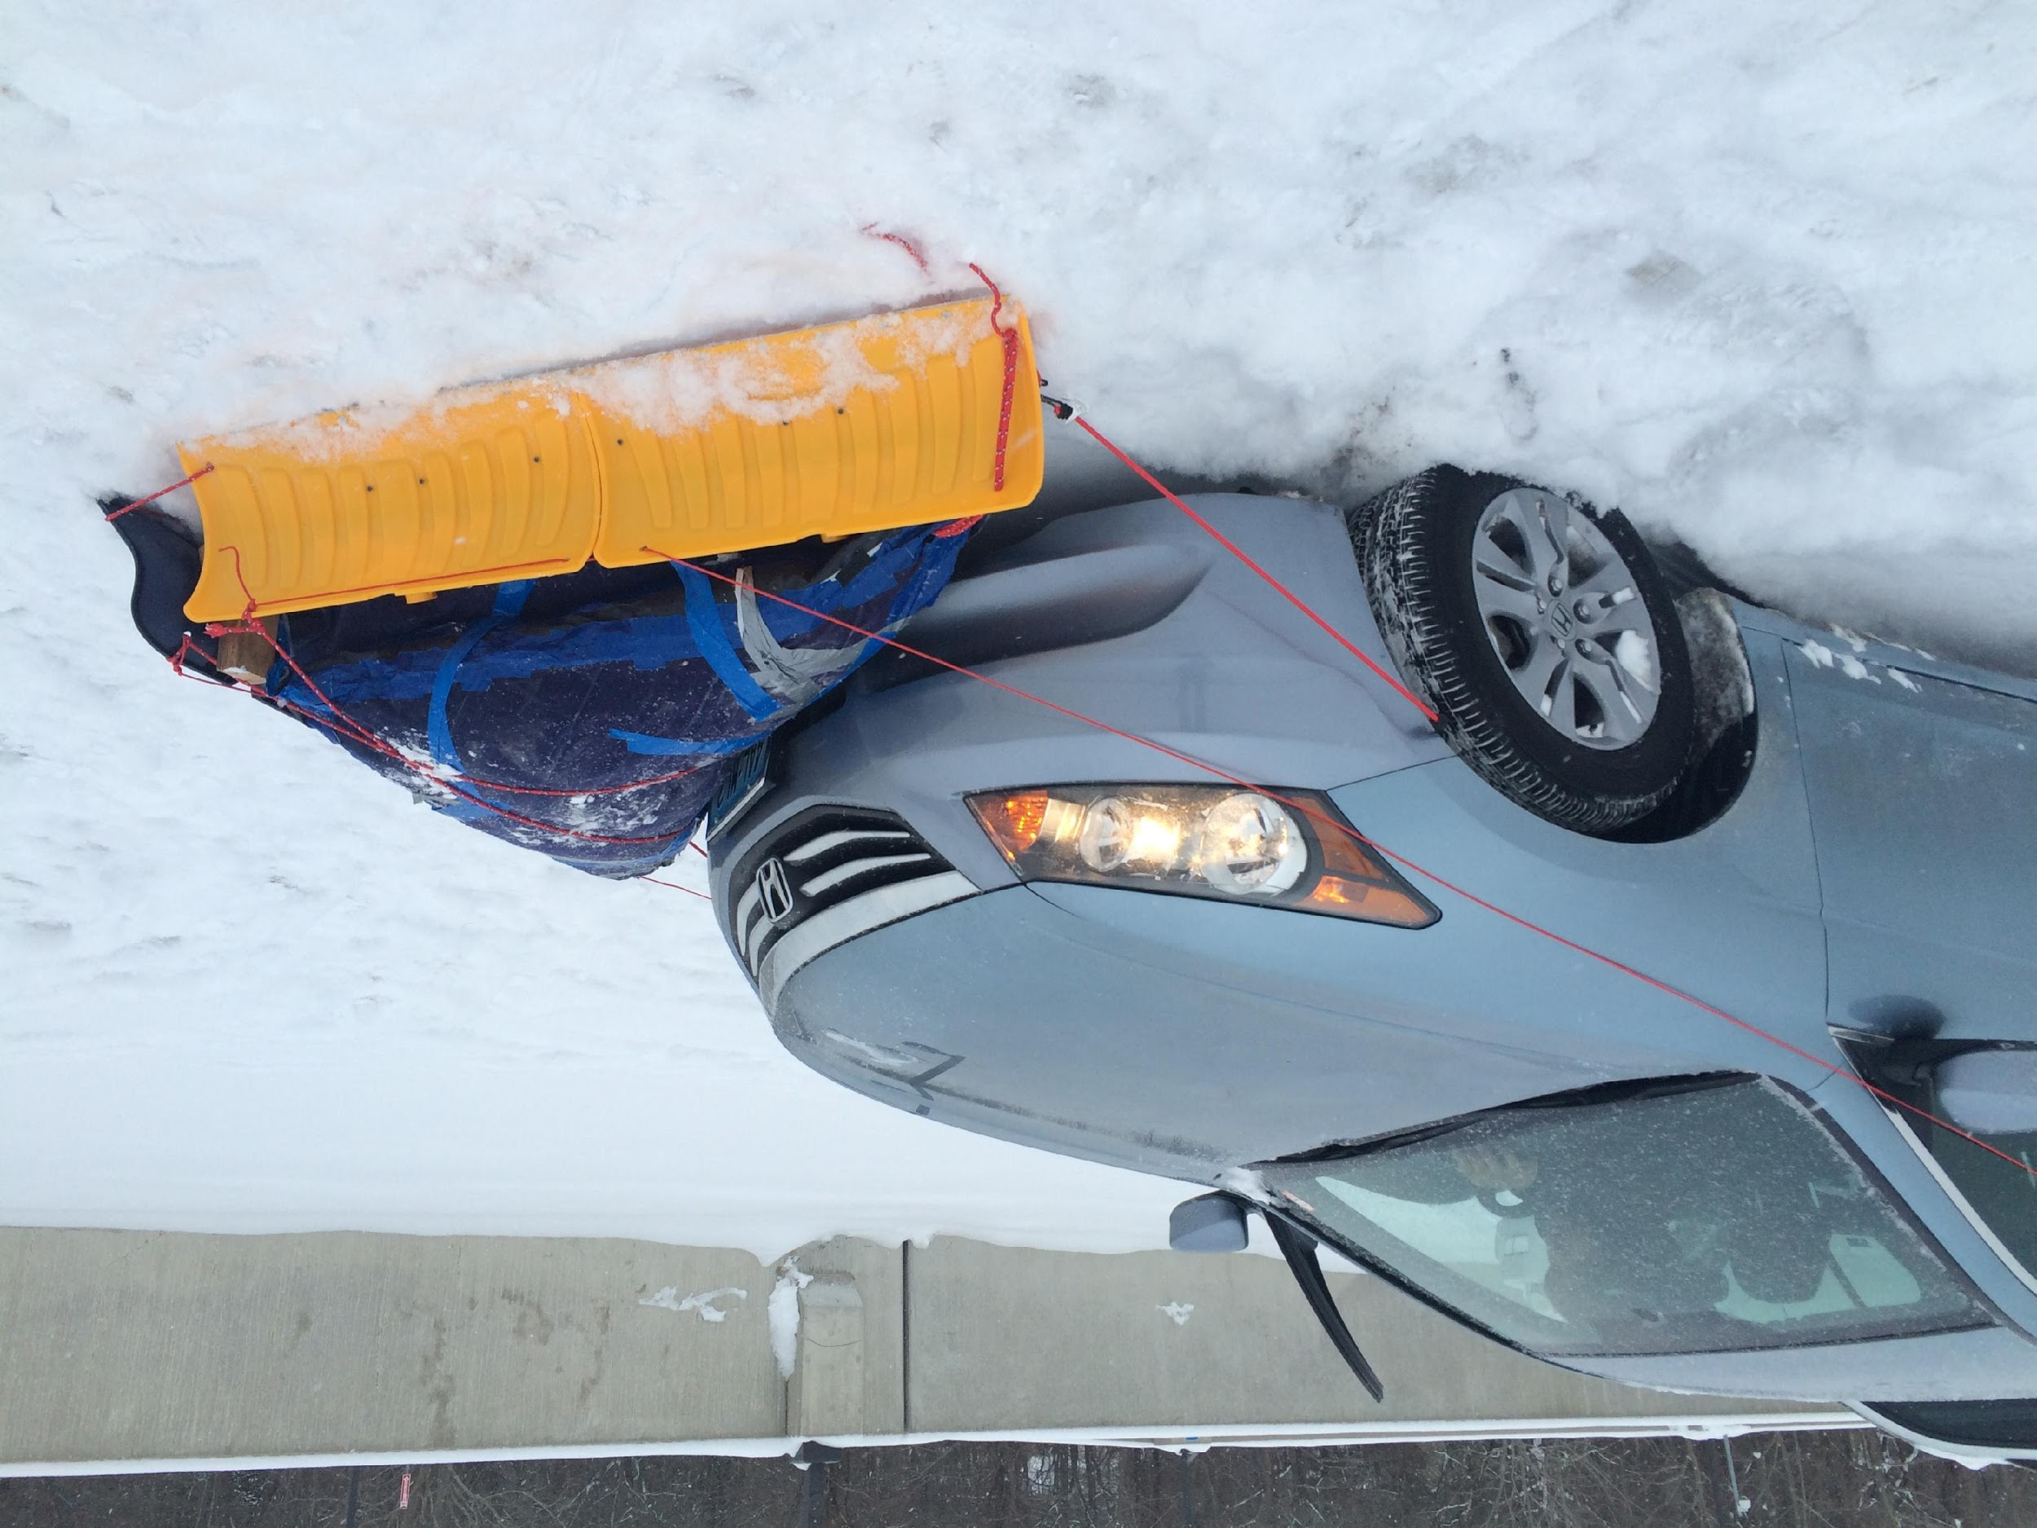
Prototype:1-B

Slide 10
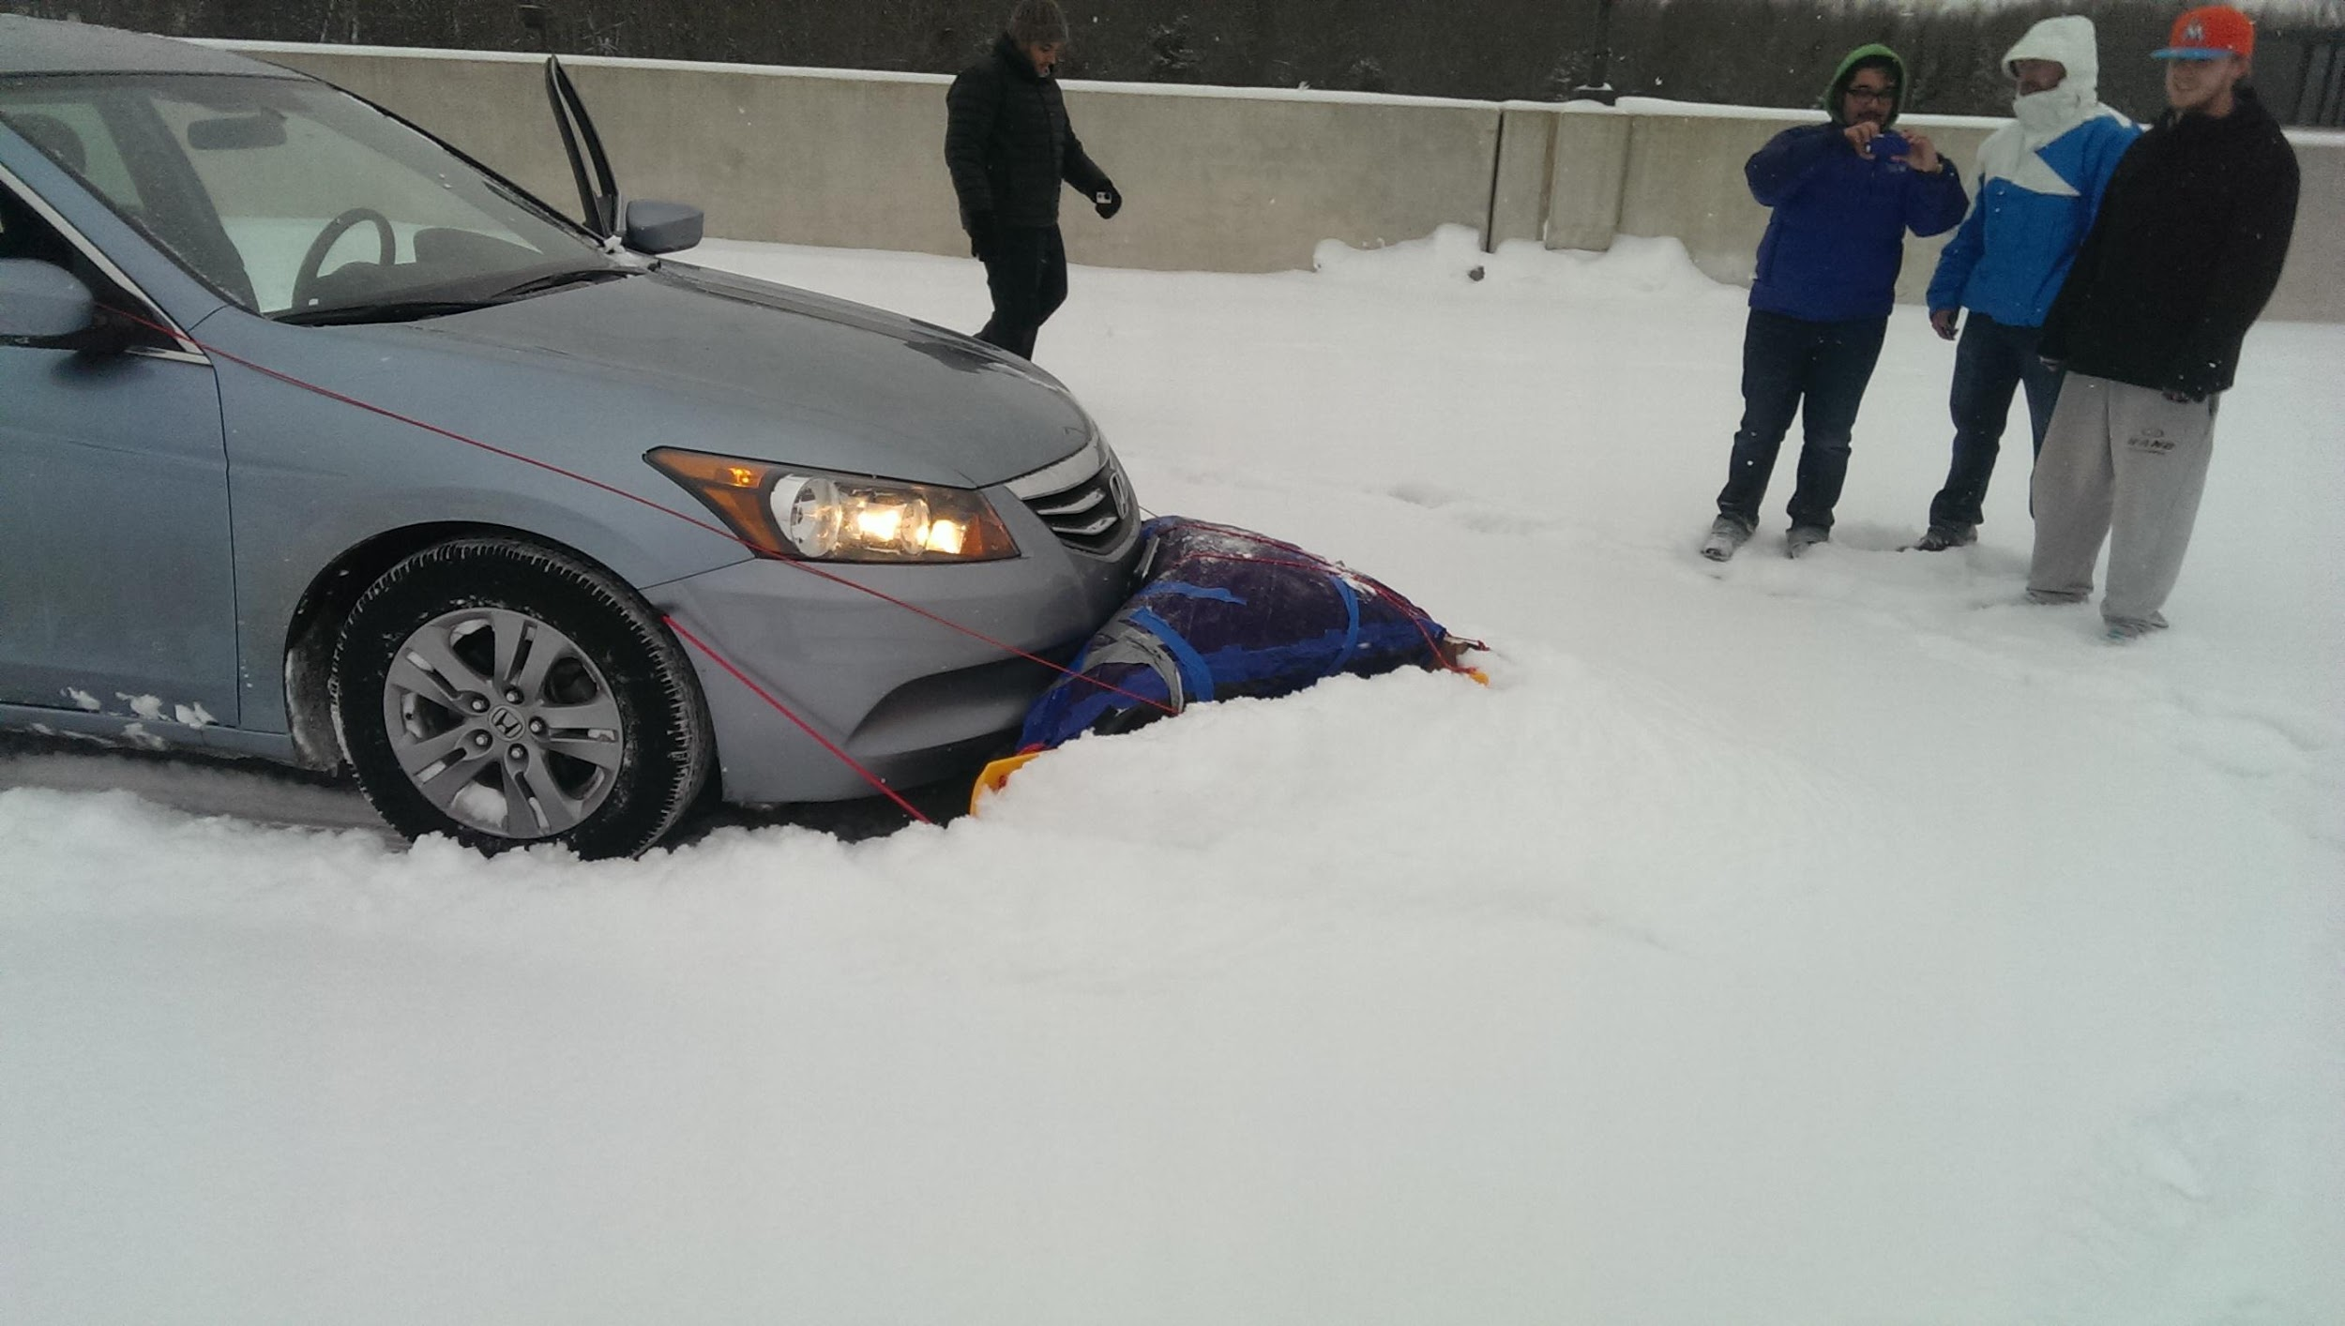
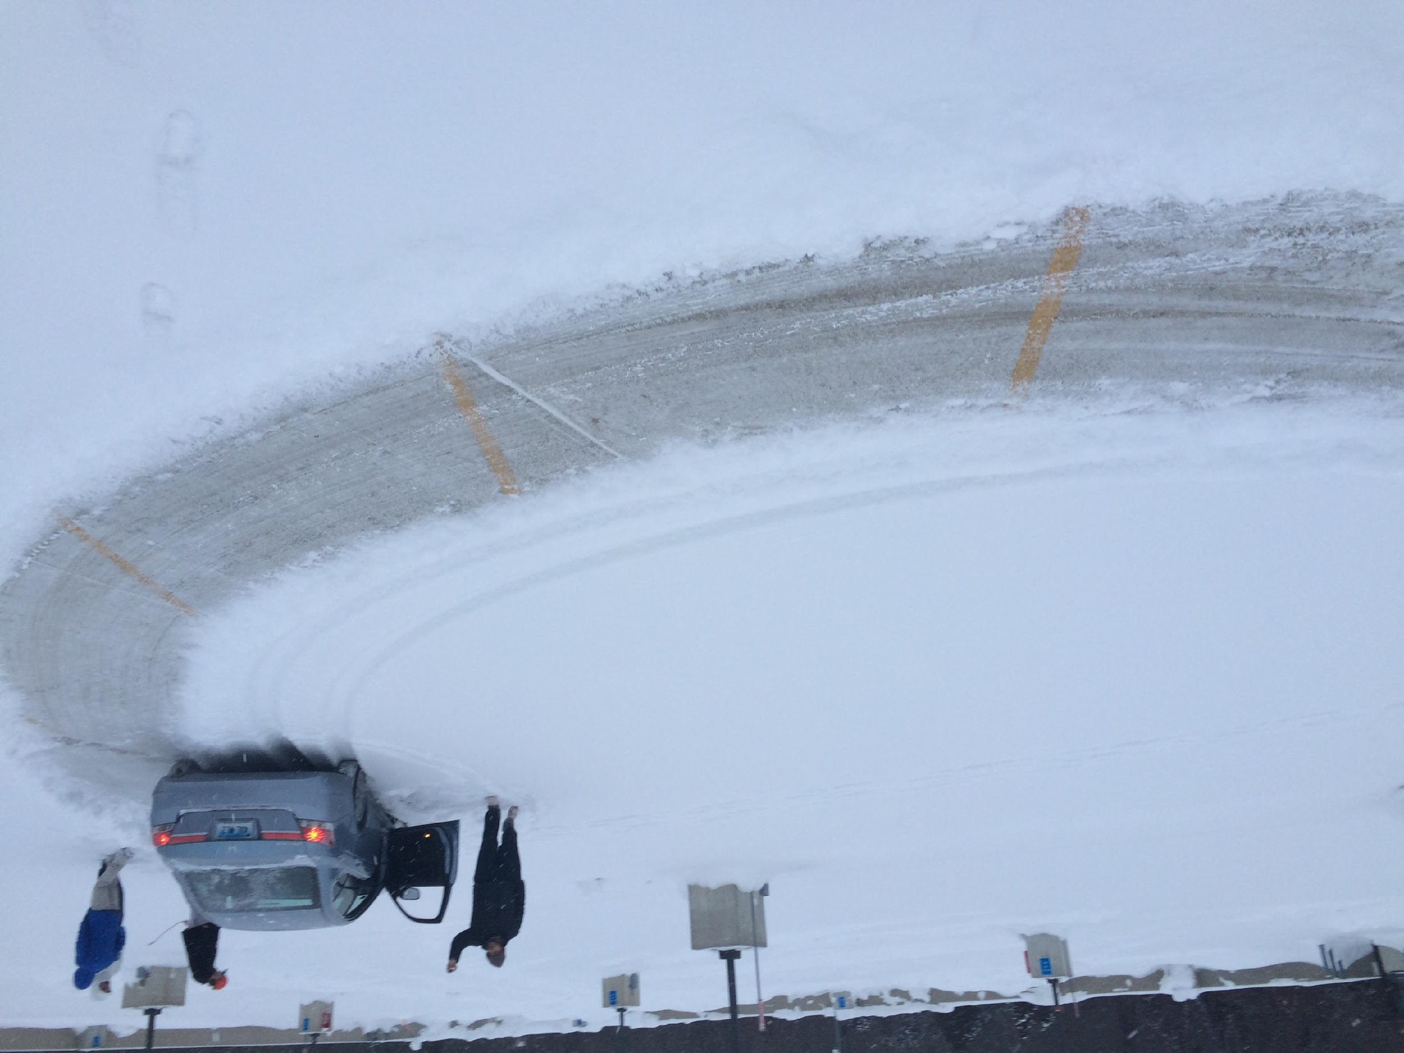
Prototype:1-B Testing

Slide 11
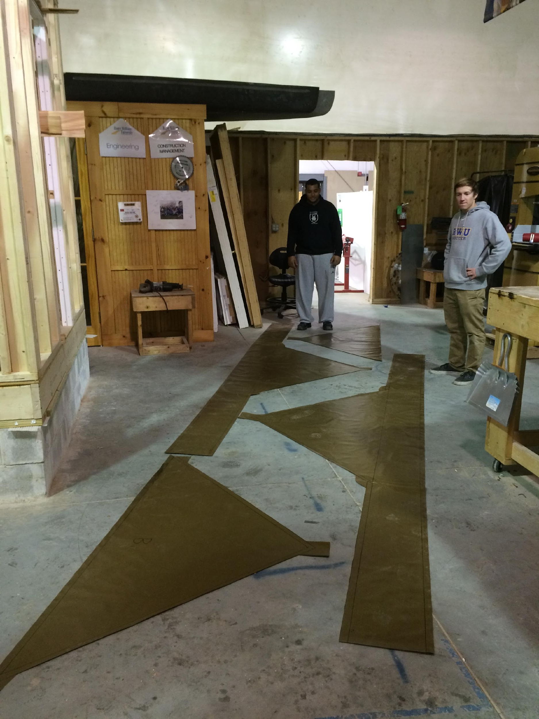
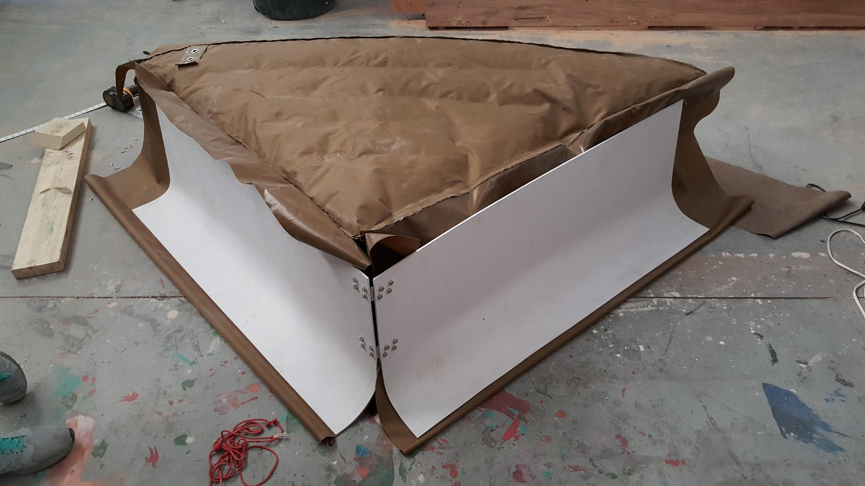
Prototype: 2

Slide 12
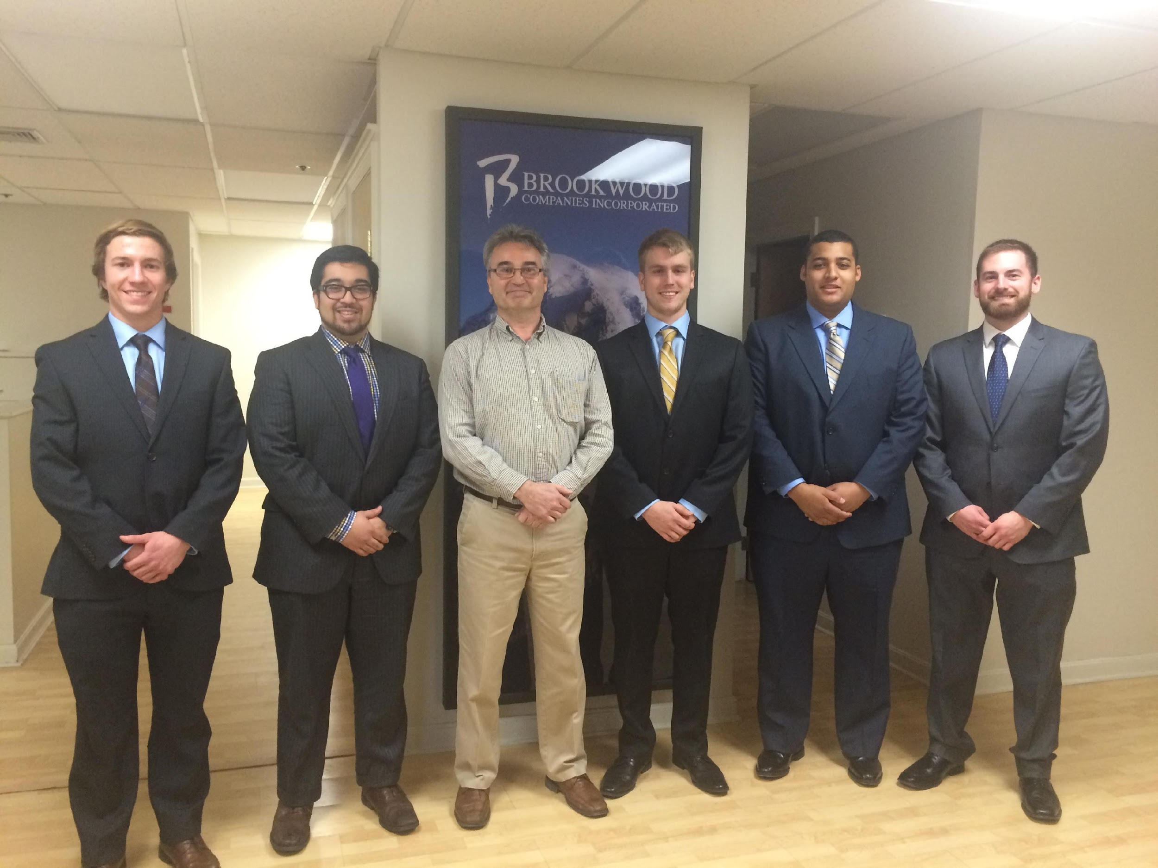
THANK YOU

